Slide 1
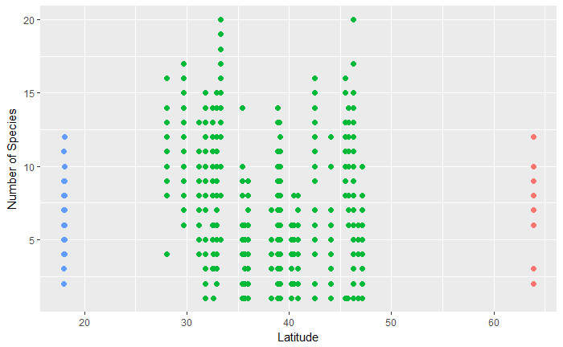
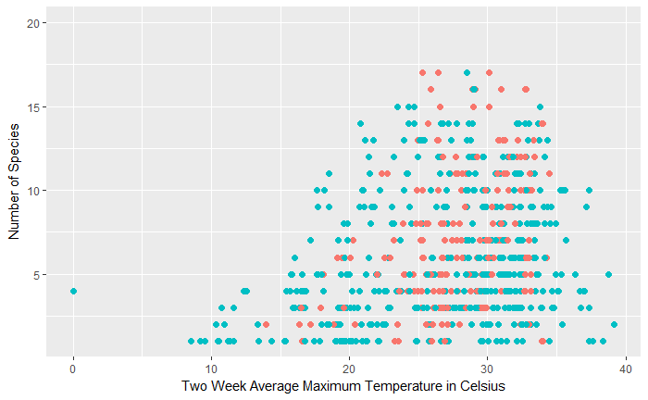
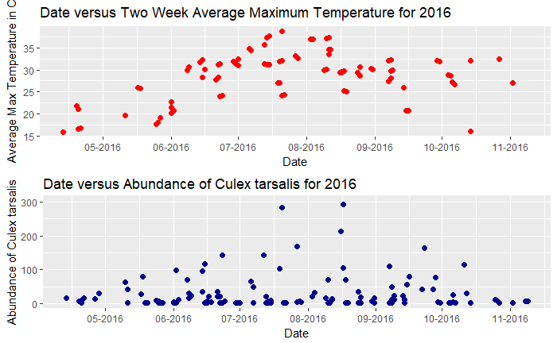
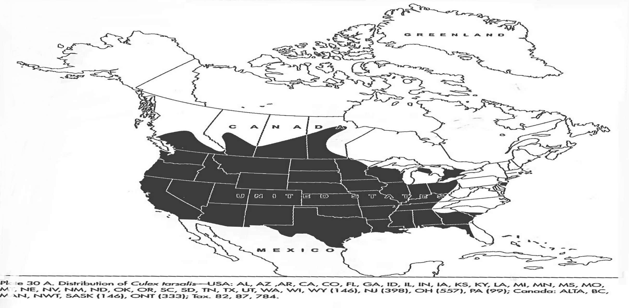
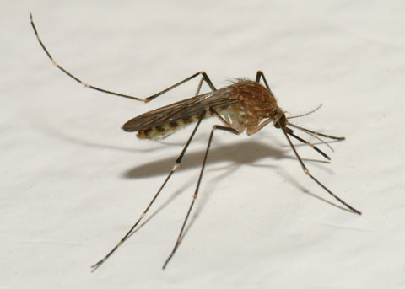
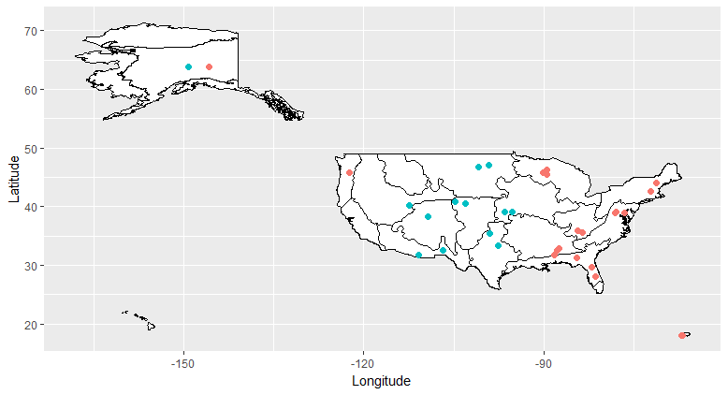
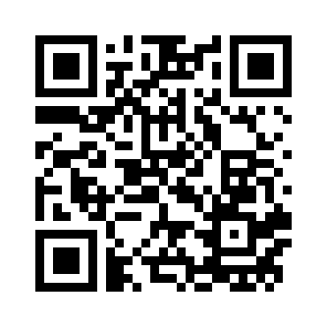
Methods of Exploring Spatial Patterns and Mapping NEON Mosquito Data in R
Charlotte Roiger
Creating a Tutorial for NEON Mosquito Data
Species Richness by Latitude
Species Richness by Average Maximum Temperature
Temperature and Abundance of Culex tarsalis Over Time
Background: The study of mosquitoes is important because of their roles as members of food chains, carriers for human diseases, and as a sentinel taxon for climate change¹. The National Ecological Observatory Network (NEON) will be collecting mosquito occurrence, identification, and pathogen data at 47 terrestrial sites over the next 30 years.
Project Goals: The aim of this research project is to develop and provide future data users with methods and examples of working with NEON mosquito data to facilitate data analysis and visualization using the R programming language. We present a general workflow for downloading, merging, and processing data from NEON’s mosquito data product to explore and visualize species richness across all NEON sites. The tutorial includes examples of how to combine field observations with meteorological data to explore the relationship between mosquito species richness and temperature thresholds. The broad spatial distribution of NEON sites may enable early detection of mosquito species range expansion. We show how these data can be used to analyze the presence or absence of a single species, Culex tarsalis, across NEON sites.
Puerto Rico
Continental United States
Alaska
2014
2016
Figure 3. Both two week average maximum temperature and abundance of Culex tarsalis have a maximum around August for the year 2016. The correlation of temperature and abundance over time suggest that these two variables could be related.
Figure 1. Scatterplot of Species Richness by Latitude. There does not appear to be a discernable pattern or relationship between species richness and latitude.
Figure 2. The clustering of species richness between 25 and 30 degrees Celsius is indicative of a weak relationship between temperature and species richness.
Range of Culex tarsalis
Picture of a Female Culex tarsalis
NEON mosquito data indicates that the range of Culex tarsalis has expanded:
Climate change will likely make more habitats suitable for Culex tarsalis now and in the future
A comparison of the established range of Culex tarsalis (top) to NEON site where Culex tarsalis was present (bottom) reveal that this species has been found in habitats farther north from its typical range.
Range expansion in response to environmental changes will likely become more commonplace and “climate change may broaden the range of some mosquito-borne pathogens and as a result expose new human populations to these disease-causing agents”⁵.
Lesson Outline
Data Organization and Set Up
Retrieve NEON Location Information
Use a function that calls NEON APIs to obtain location data
Merge trapping, identification, and sorting data frames
Vignette One: Mosquito Species Richness
Calculate Species Richness
Count the unique number of scientific names at each sampling site by using the ‘ddply’ function
Create Temperature and Degree Day Variables
Create a temperature lag function that calculates the average maximum temperature and number of days above 16º Celsius two weeks prior to sampling²
Apply the temperature lag function to a species richness data frame using the ‘mapply’ command
Vignette Two: Abundance and Range of Culex tarsalis
Calculate Abundance
Create a subsample multiplier to estimate the number of individuals in each sample
Sum individual count from samples by site identification and date
Visualize Culex tarsalis Range
Download NEON domain shapefiles
Create indicator variable of Culex tarsalis native status and sampling presence
Use the ‘ggplot2’ package to visualize NEON domain map
Native Status
Native
Figure 4. Culex tarsalis is an especially important species to study because their role as carriers of the West Nile Virus. Pictured here is a female Culex tarsalis.³
Absent
Acknowledgments
Figure 5. Map of North America depicting the range of Culex tarsalis from Darcie and Ward’s “Identification and geographical distribution of the mosquitoes of North America, north of Mexico,” published in 2005⁴.
Special thanks to Cody Flagg, Megan Jones, and Katie LeVan for providing mentorship, coding expertise, and support throughout the creation of this data tutorial.
References
Culex tarsalis Present in Samples
Hoekman, D., Y. P. Springer, C. M. Barker, R. Barrera, M. S. Blackmore, W. E. Bradshaw, D. H. Foley, H. S. Ginsberg, M. H. Hayden, C. M. Holzapfel, S. A. Juliano, L. D. Kramer, S. L. LaDeau, T. P. Livdahl, C. G. Moore, R. S. Nasci, W. K. Reisen, and H. M. Savage. 2016. Design for mosquito abundance, diversity, and phenology sampling within the National Ecological Observatory Network. Ecosphere 7:1–13.
Ciota, A., M. A., K. A., K. L. 2014. The Effects of Temperature on Life History Traits of Culex Mosquitoes.
Bryant, P. J. 2007. Western Encephalitis Mosquito. Natural History of Orange County, California and Nearby Places. University of California, Irvine.
Darsie, R. F., R. A. Ward, C. C. Chang, and T. Litwak. 2005. Identification and geographical distribution of the mosquitoes of North America, north of Mexico. University Press of FloridaGainsville, FL.
Hongoh, V., L. Berrang-Ford, M. E. Scott, and L. R. Lindsay. 2012. Expanding geographical distribution of the mosquito, Culex pipiens, in Canada under climate change. Applied Geography 33:53–62.
Present
Not Present
For more information on project methods and access to code, please scan this QR code. To access NEON mosquito data, please visit data.neonscinec.org/home
Figure 6. Map of the United States showing all sites sampled in either 2014 or 2016 and sites where Culex tarsalis was present in sampling. Culex tarsalis was found to be present in Alaska, outside of its typical range, in 2016.

